Slide 1
Sharing Business Common Logic Between Components
X
By : Ridoan Saleh Nasution
17.00 - Finish (SGT)
May 29th, 2020
(Live on Teams)
AIA Singapore

Slide 2
About Me
Name : Ridoan Saleh Nasution
Job Title : Fullstack JavaScript Developer
Office : Batam, Indonesia

Slide 3
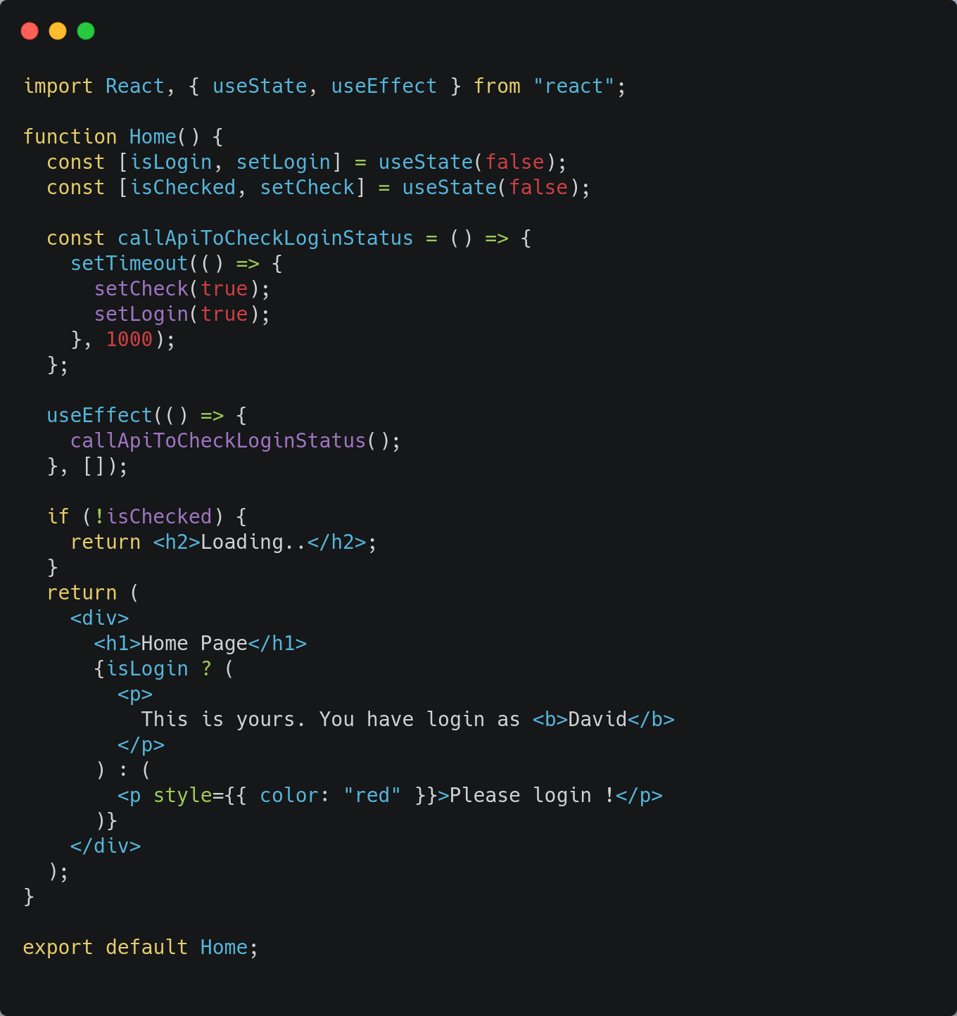
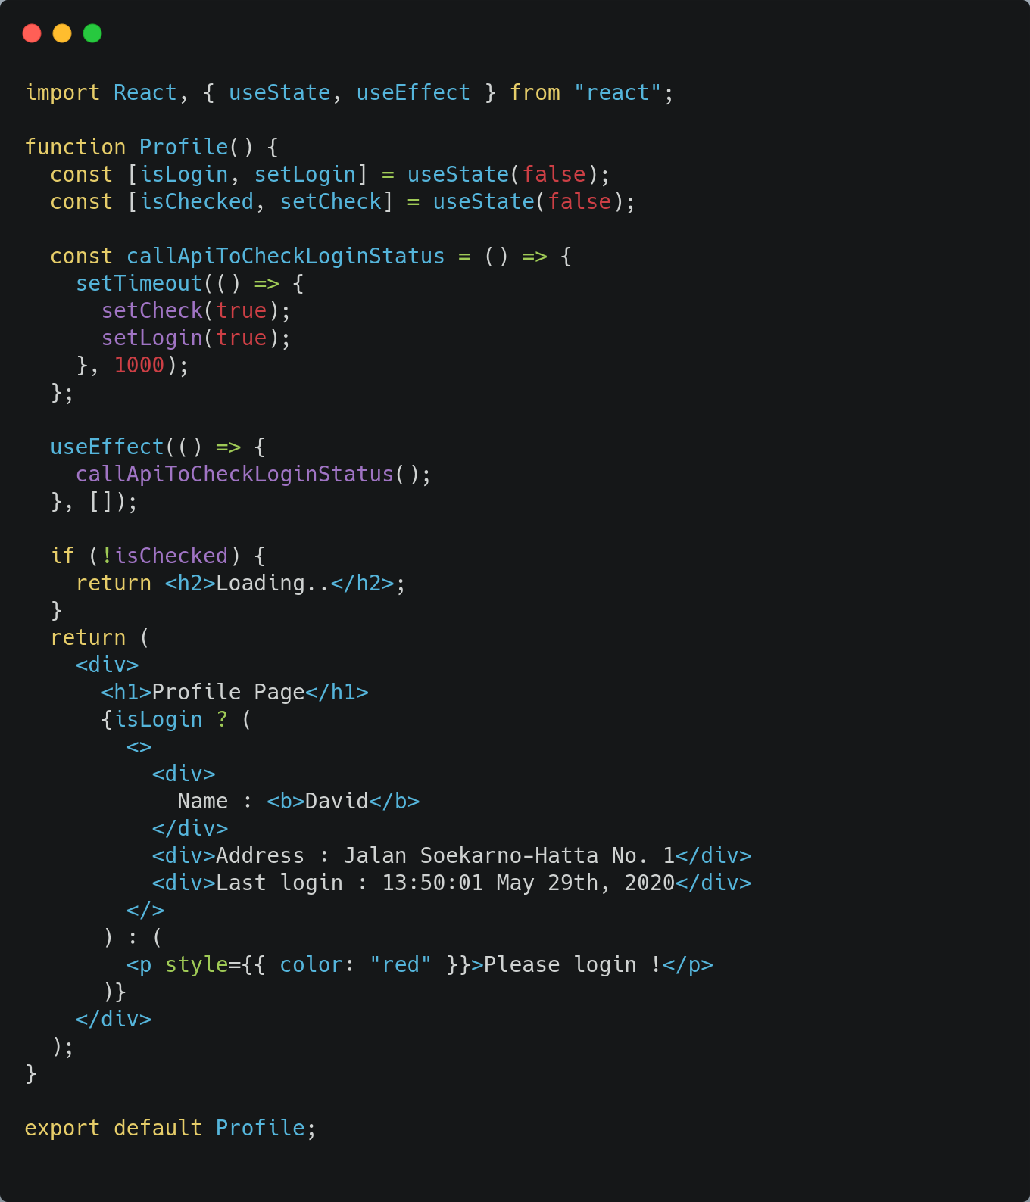
Somewhere, in a React Project

Slide 4
Four Patterns
Mixins (dead)
Render Props
HOC
Custom Hooks

Slide 5
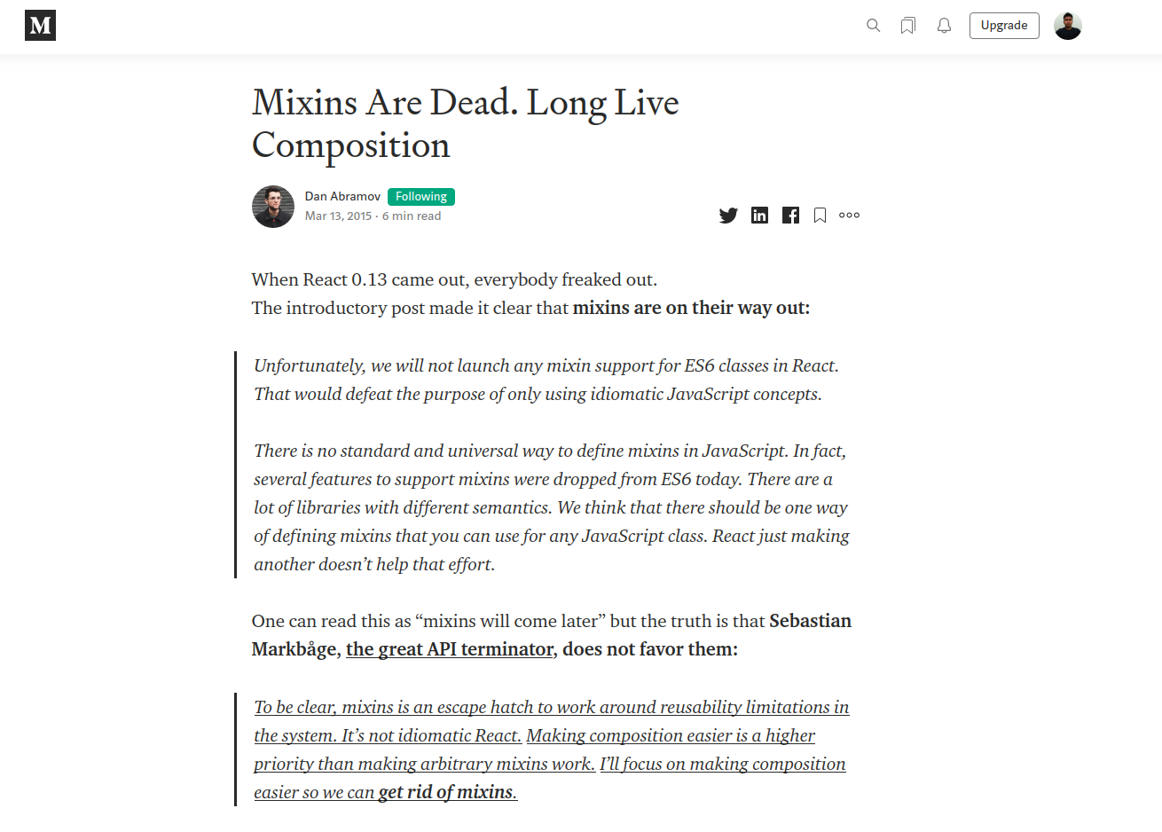
CONFIRMED

Slide 6
How to start ? Any Requirement !
You have more than 1 component that use the same logic
It is related to the use of React functionality like state or lifecycle. If it is NOT, create a utility function instead.
You want to follow DRY principle.

Slide 7
Render Props
The term “render prop” refers to a technique for sharing code between React components using a prop whose value is a function.

Slide 8
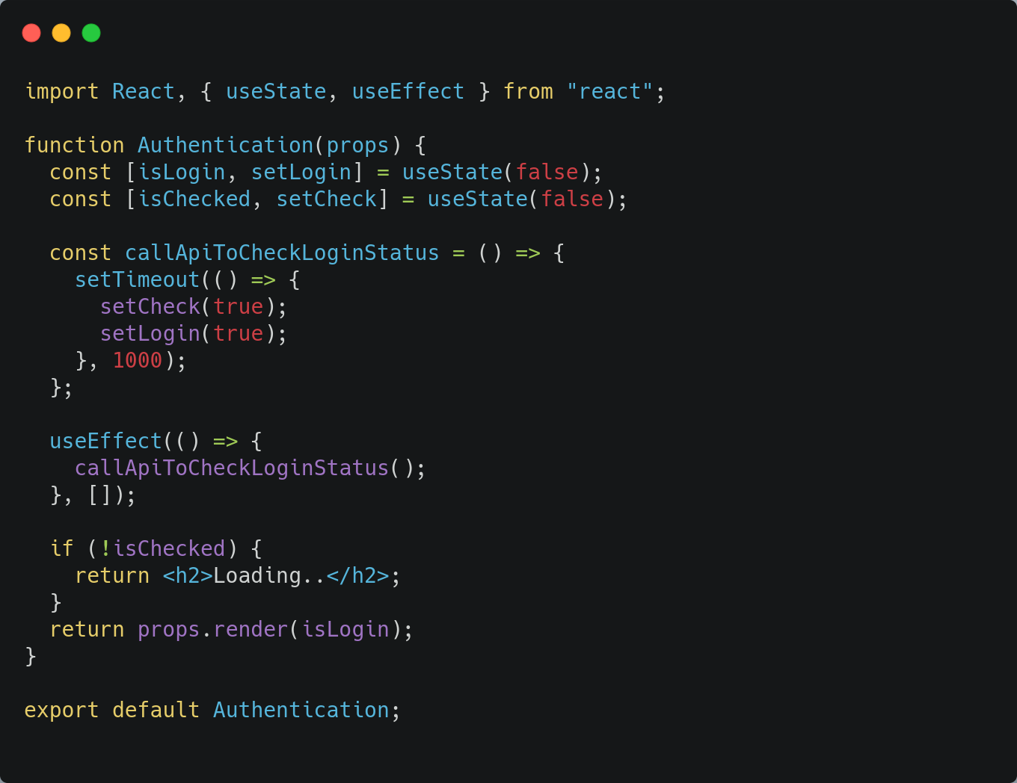
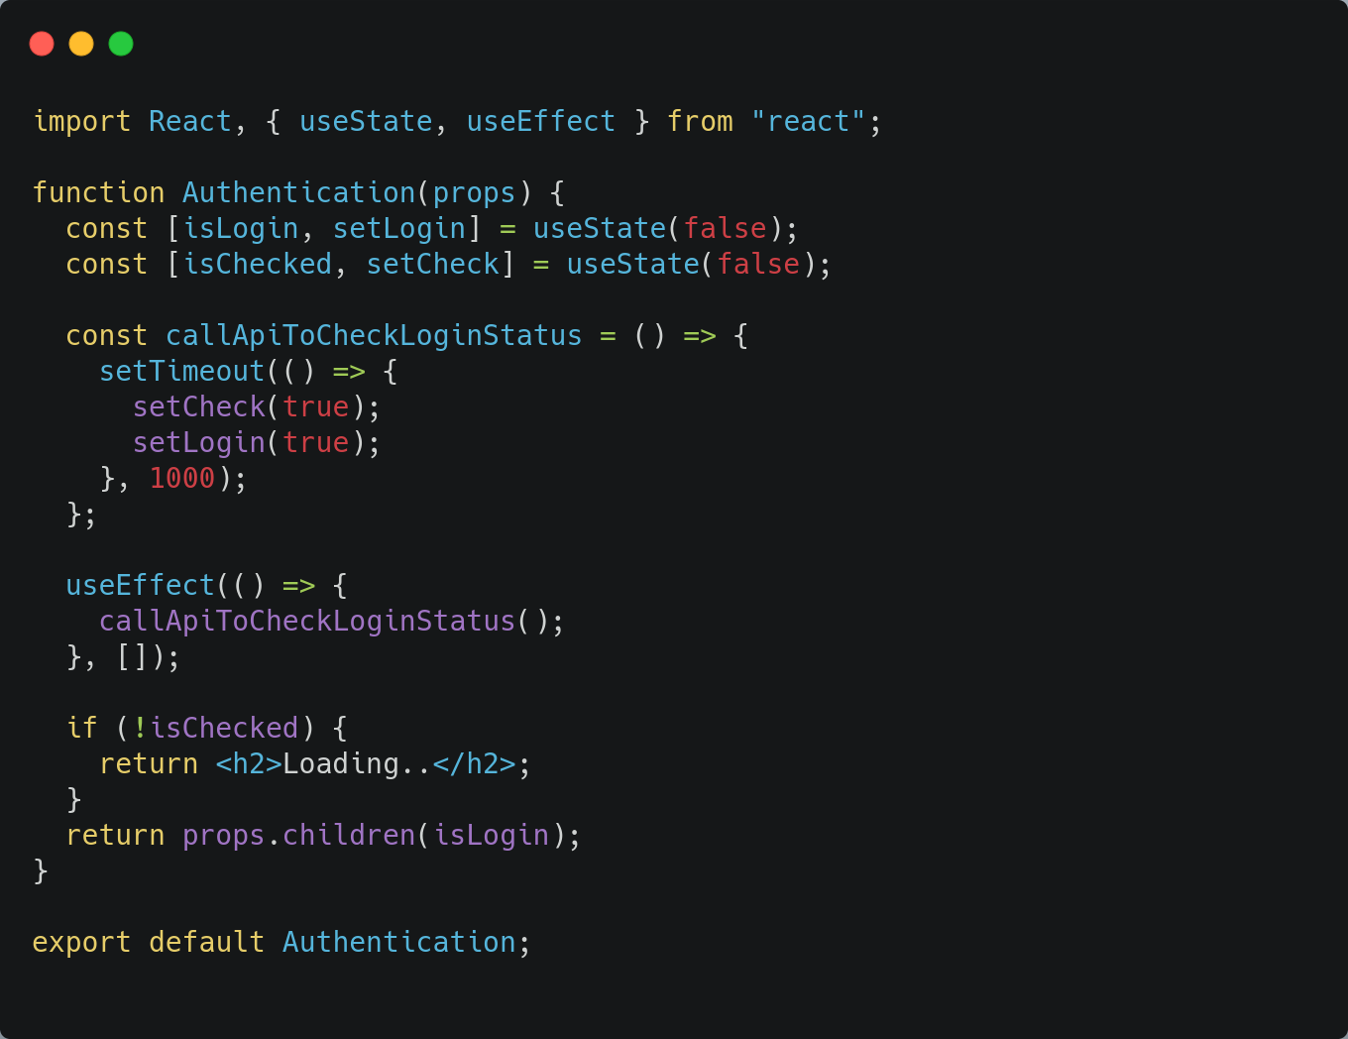
Render Props Component - Authentication
render
VS
children

Slide 9
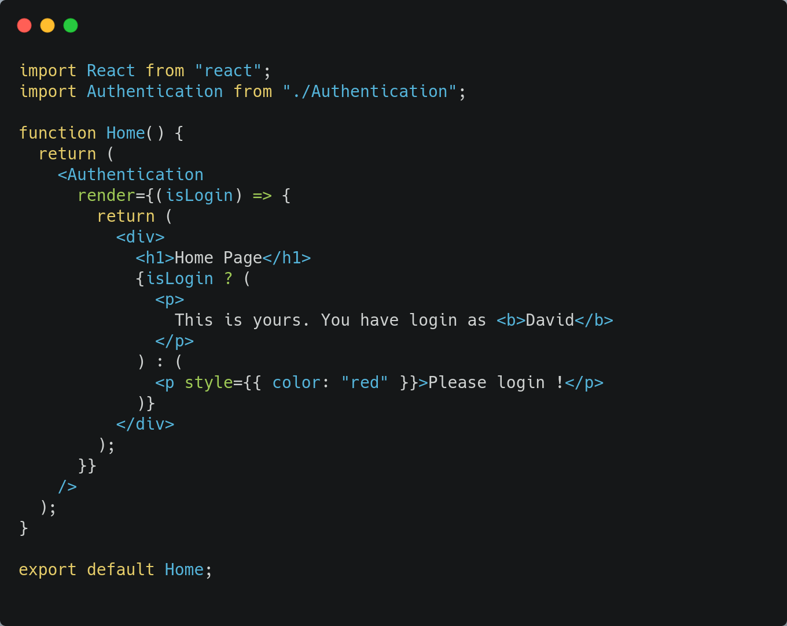
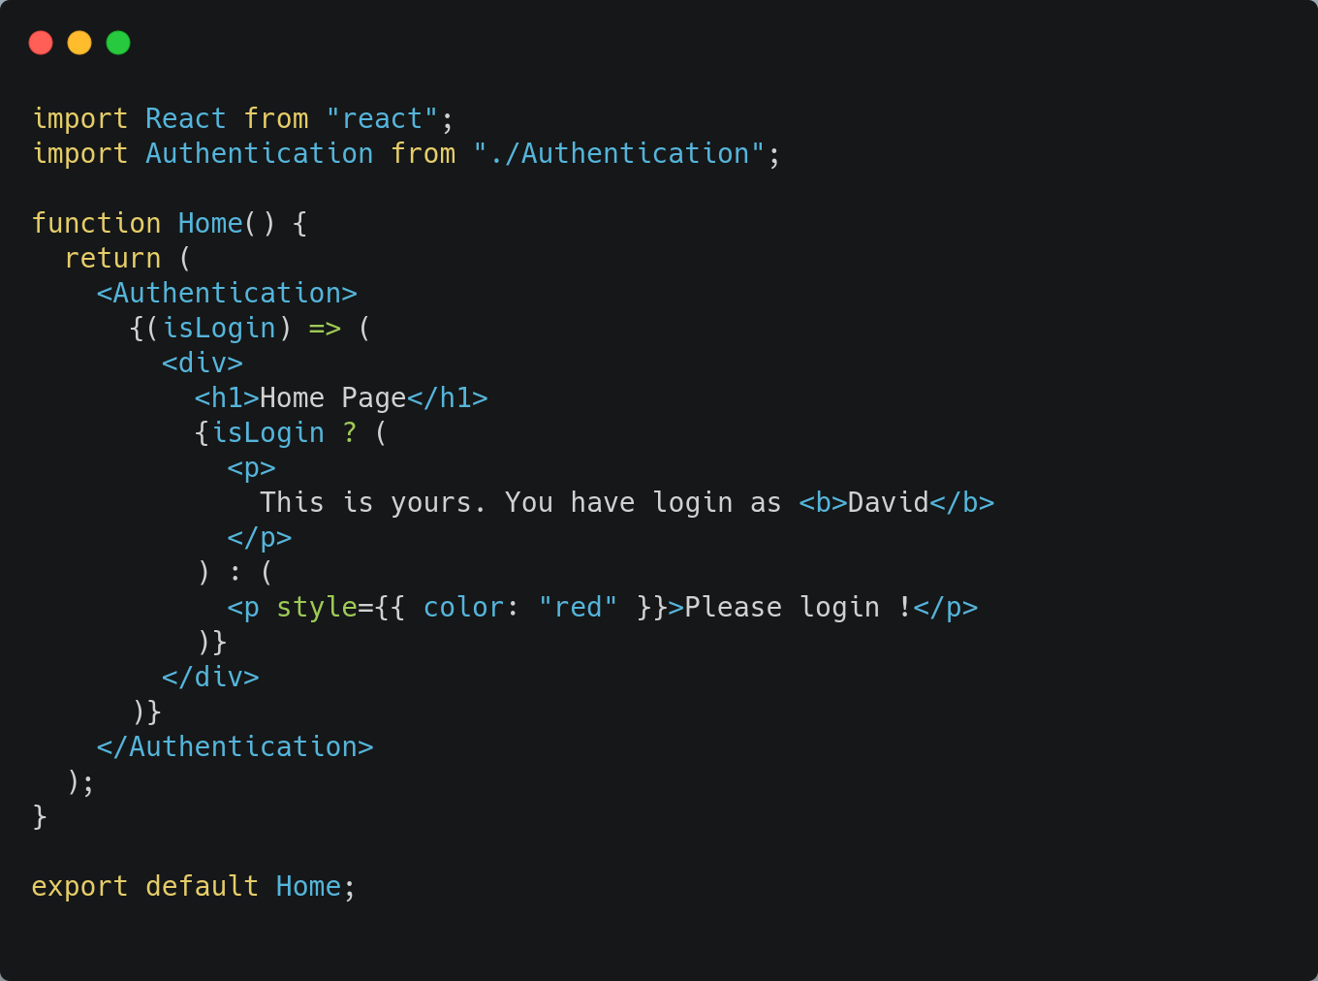
Component - Home
render
children

Slide 10
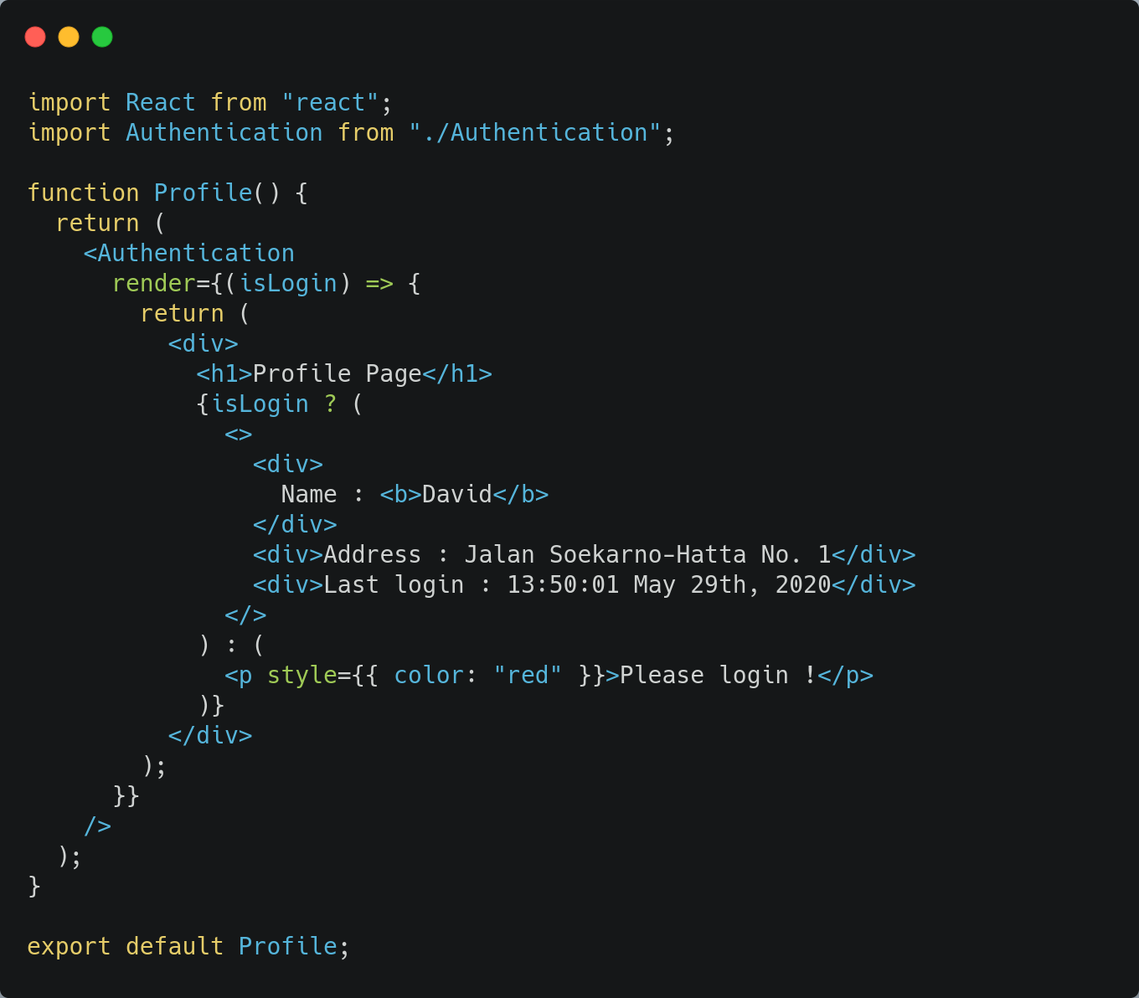
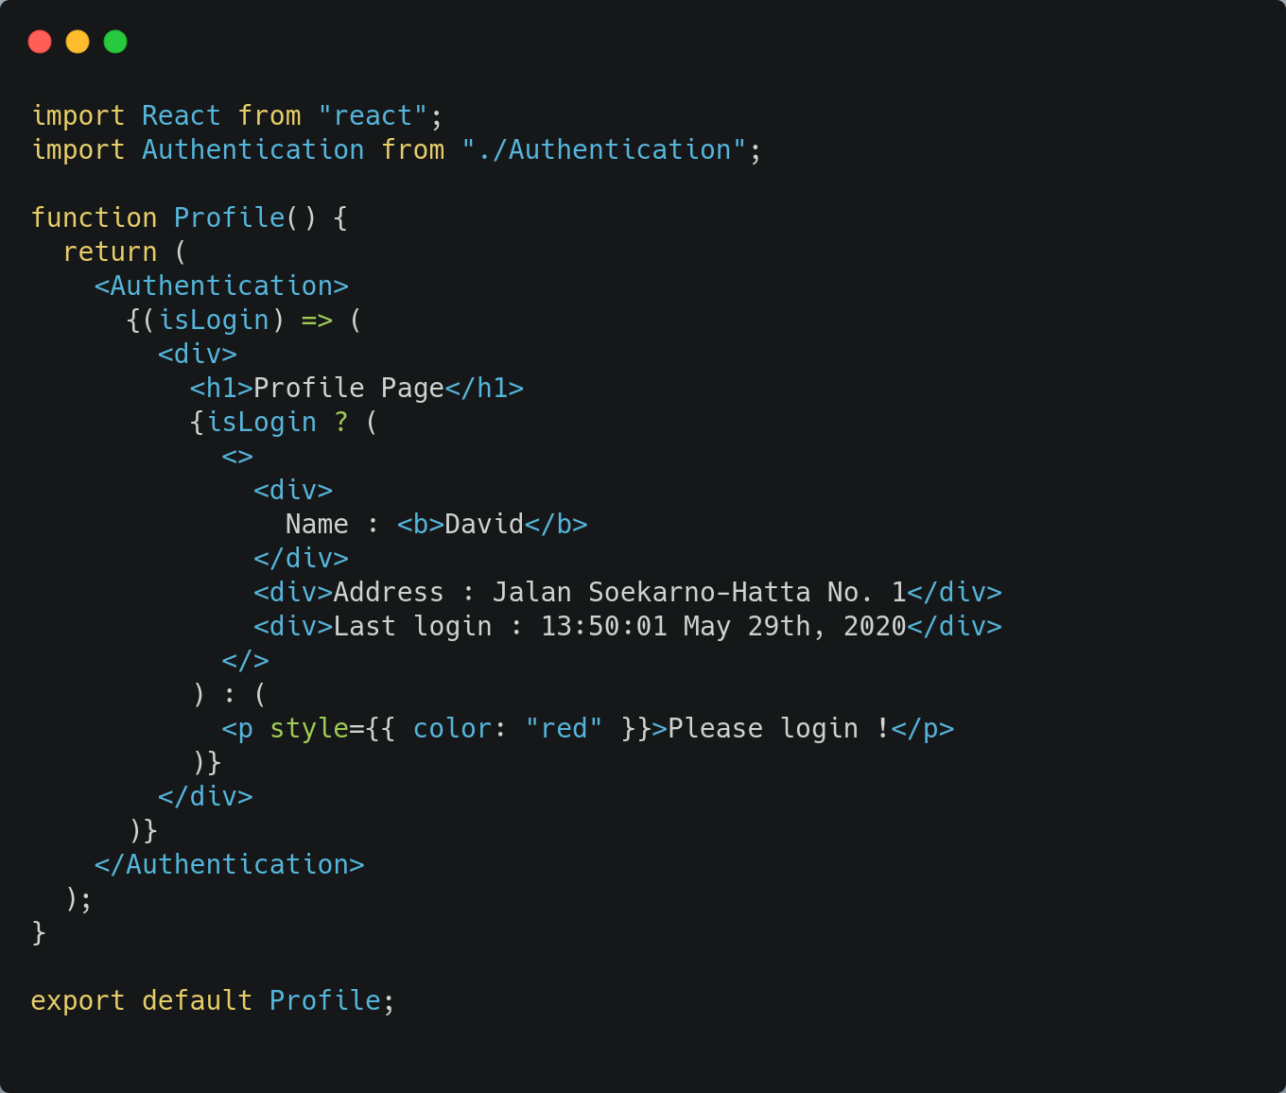
Component - Profile
render
children

Slide 11
Higher-Order Components (HOC)
A higher-order component (HOC) is an advanced technique in React for reusing component logic.

Slide 12
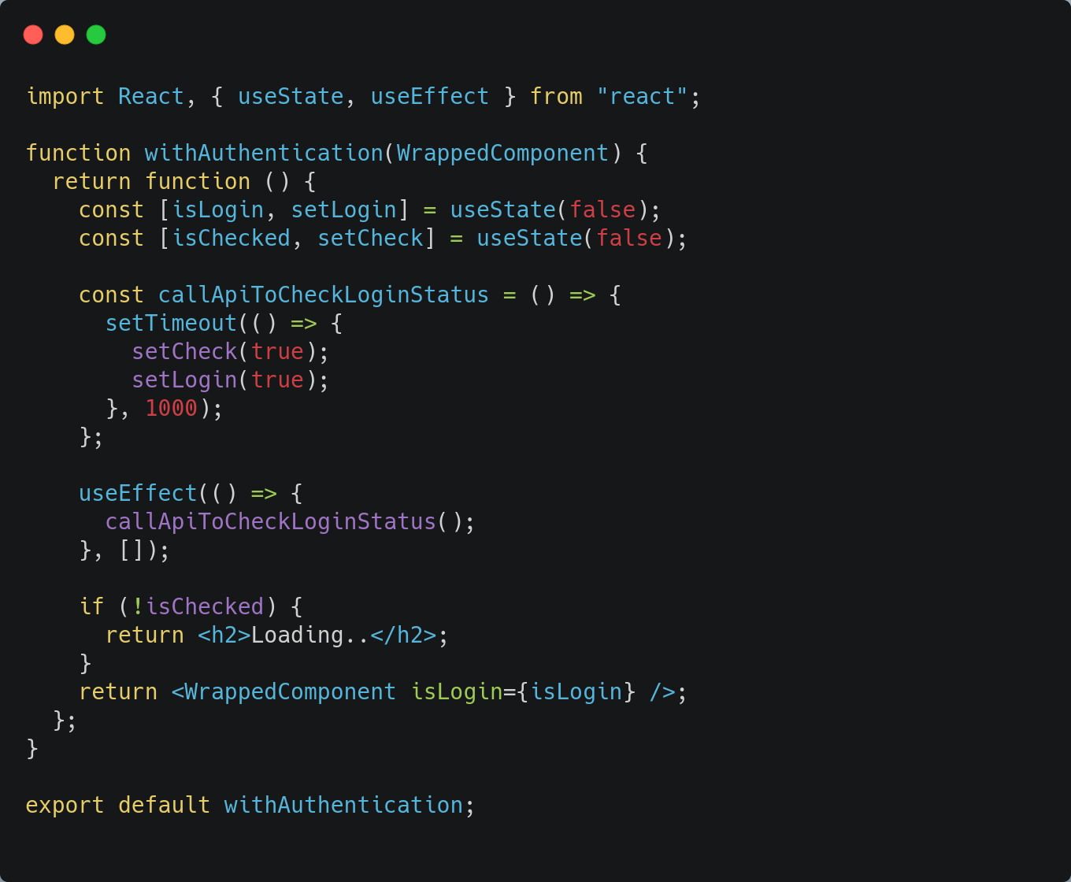
HO-Component - withAuthentication

Slide 13
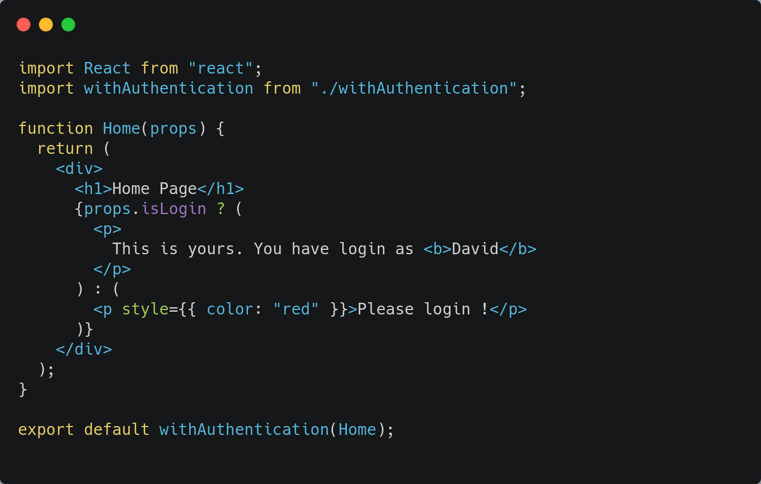
Passed Component - Home

Slide 14
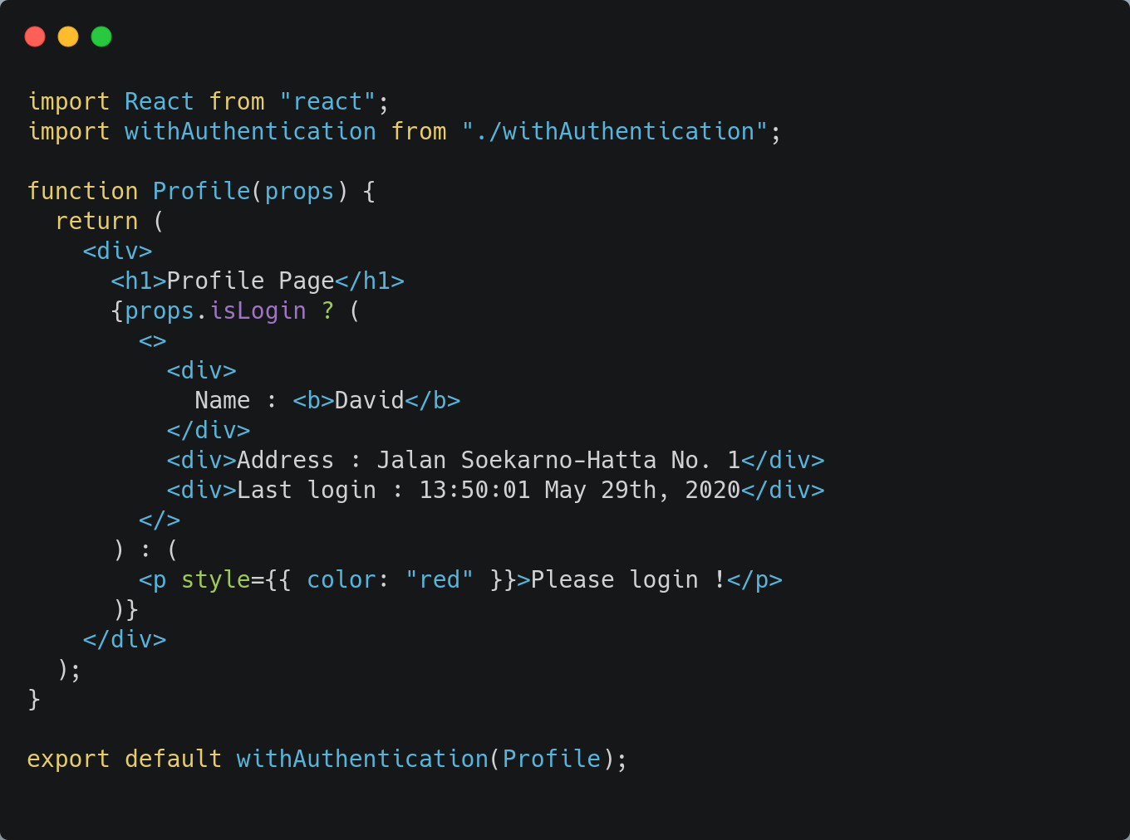
Passed Component - Profile

Slide 15
Custom Hooks
Hooks are a new addition in React 16.8. They let you use state and other React features without writing a class.
Custom Hook is a reusable function that enable developer extract component logic by using Hooks feature.

Slide 16
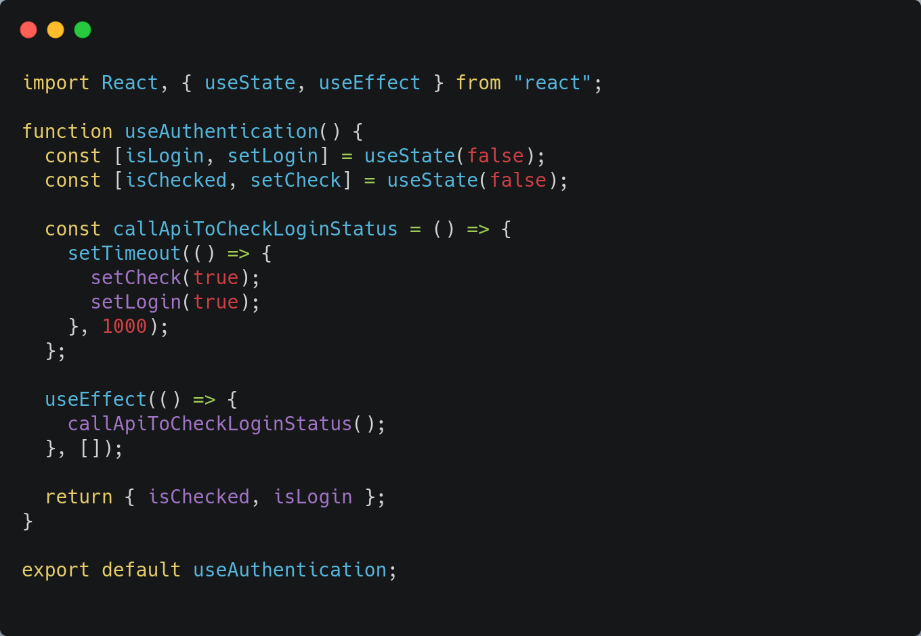
Custom Hooks Component - useAuthentication

Slide 17
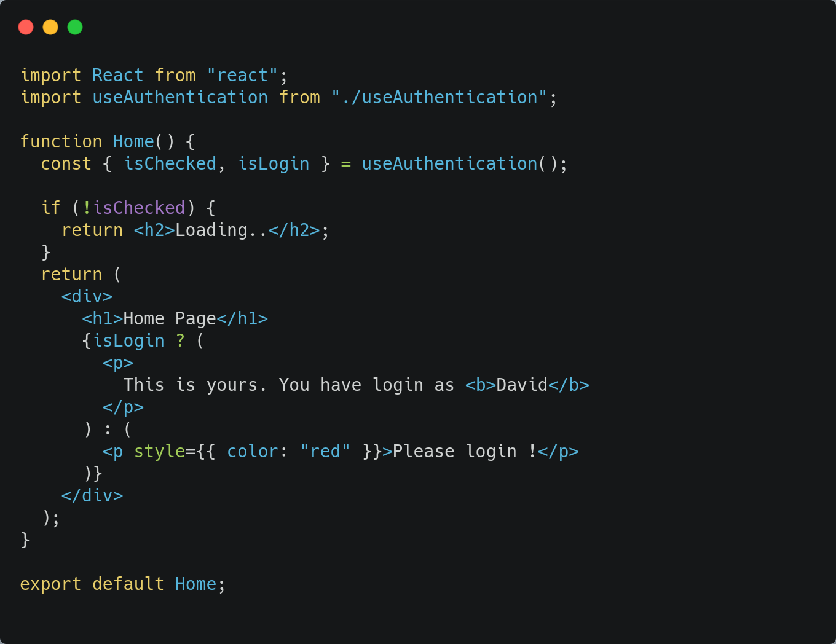
Component Consumer - Home

Slide 18
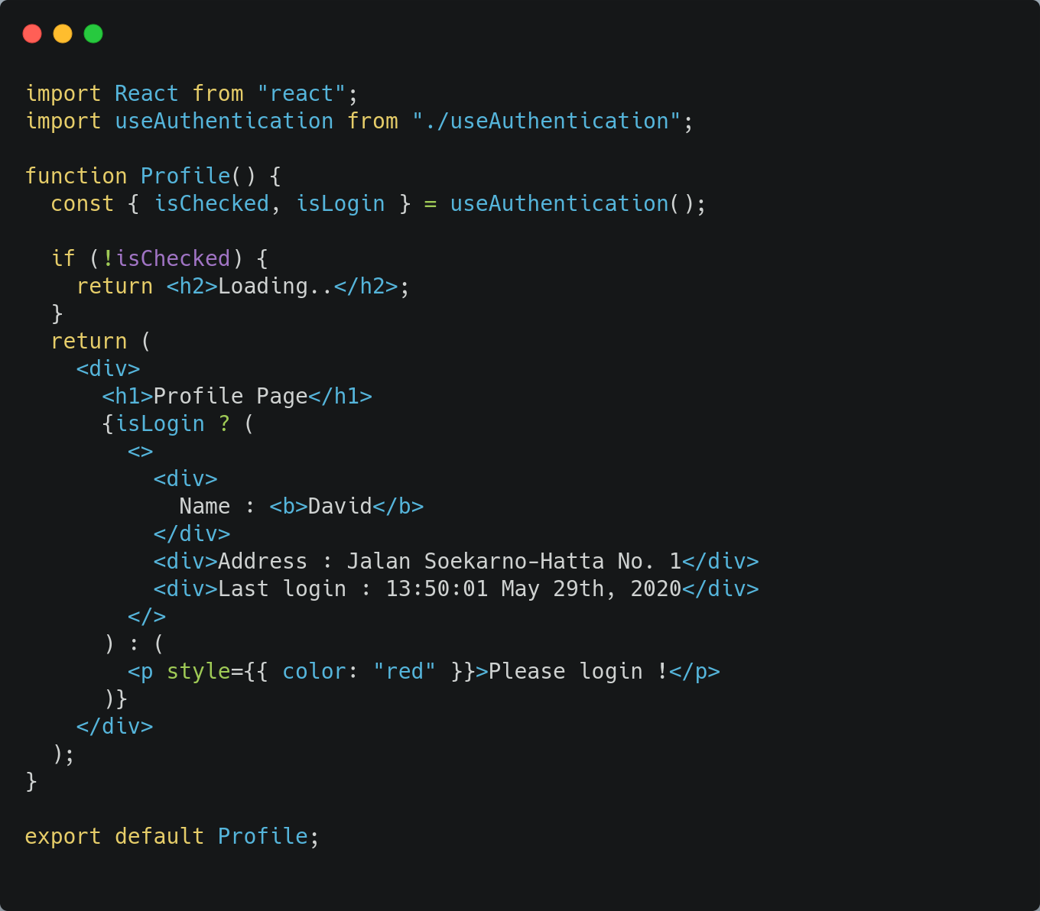
Component Consumer - Profile

Slide 19


